Slide 1
The Joint IAFSW-MiSAC Competition 2024: Neglected Tropical Diseases and Climate Change The winning and commended entries

Slide 2
1st Winner ($120/each student)
Student names:
Leyah Dulsa
Alexa Lucille Tud
John Joshua Anac-anac
Angelyn Javison
Teacher name: Stanley B. Manaay
School name: Salvacion National High School
Country: Philippines

Slide 3
2nd Winner ($60/each student)
Student names:
Queen Mary Lipaopao
Yaella Rose Briones
Mars Cheester Bulanon
Michaela Manzanero
Teacher name: Sherah S. de los Santos
School name: Sagay National High School
Country: Philippines

Slide 4
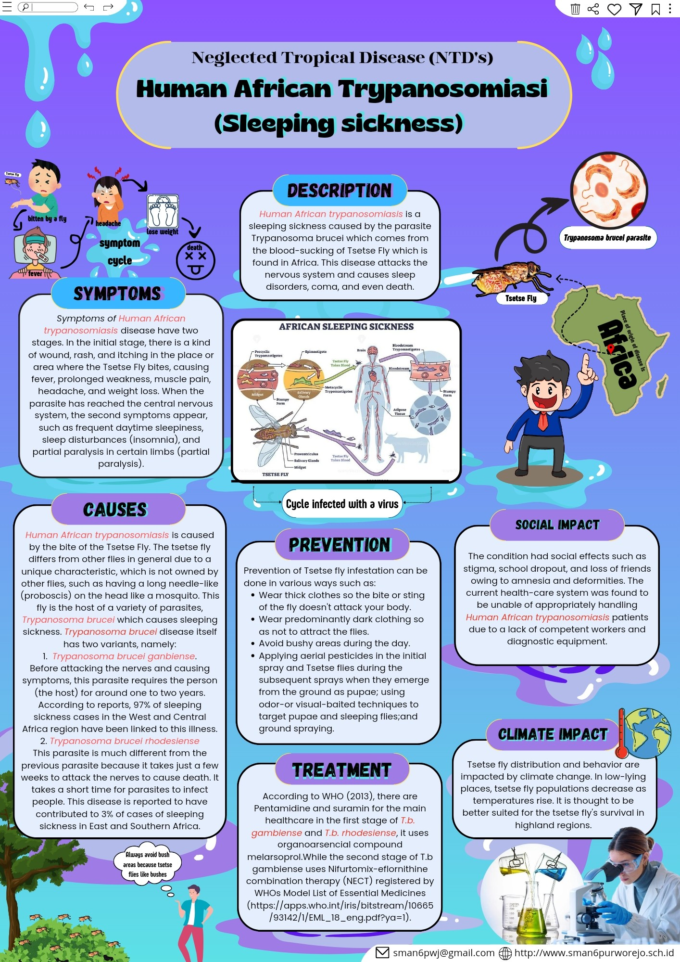
3rd Winner ($30/each student)
Student name:
Bonaventura khrisna Chrysologus
Teacher name: Fitri Nuraeni Rachmayanti, S.Pol.Gr
School name: Sma Negeri 6 Purworejo
Country: Indonesia

Slide 5
Commended for Scientific Information
Student name:
Julie Jean Palcat
Jhonemar Diabakid
Rey Jauod
Rendel Batoc
Teacher name: Jenelyn D. Ladaga
School name: Salvacion National High School
Country: Philippines

Slide 6
Commended for Attractive Visual Impact
Student name:
Keysah Amanda Maharani
Teacher name:
Andri Mangestiwi
School name:
Sma Negeri 1 Pangkalan Bun Country: Indonesia

Slide 7
Commended for Innovation
Student name: Mawali Ahmad ZuhdiChrysologus
Teacher name: Imas Masturoh
School name: Mumtaza Islamic Junior High School
Country: Indonesia

